Slide 1
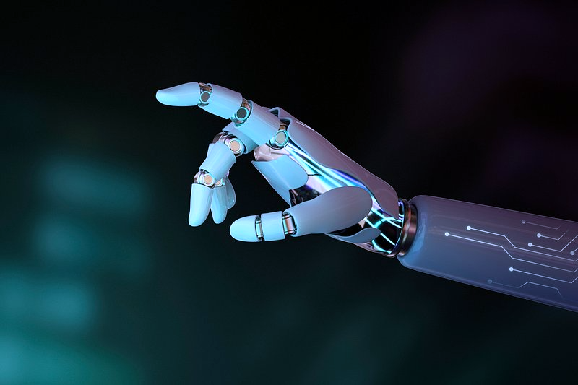
Sign Language To Text
Oren Raz and Lam Kai Yi Karen

Slide 2

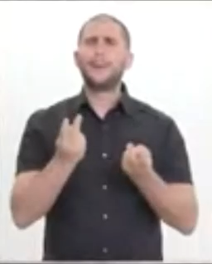

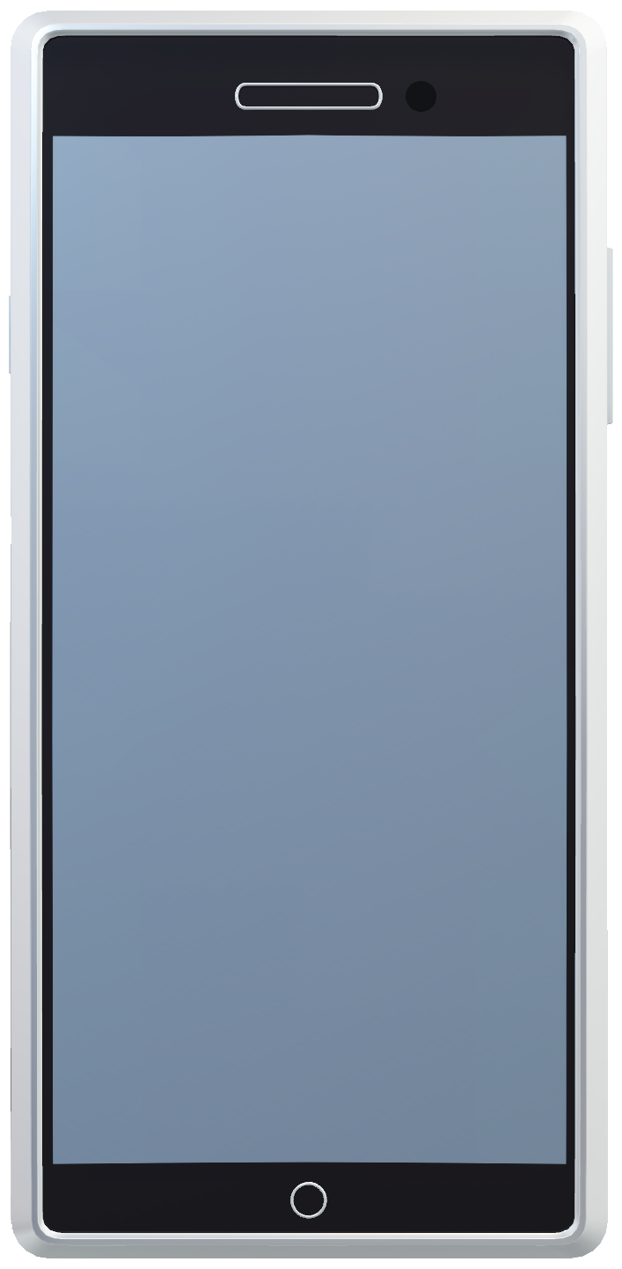
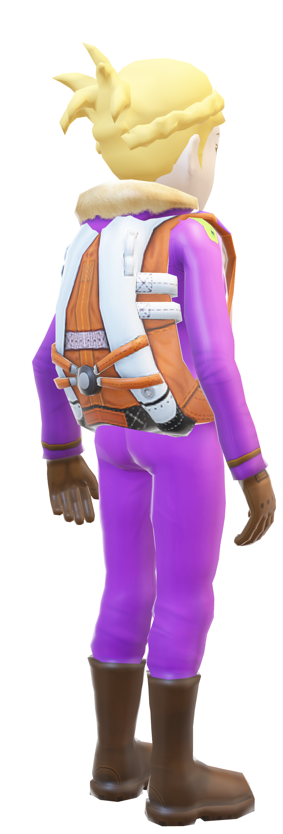
Our Vision / Problem Definition
AIM: Translate Word Level Sign Language
to Text
Sign-to-text
How?
The Goal
Bridge the communication gap between people with hearing impairment and people with no/little knowledge in sign language
Hello, my name is Jón, I am delighted to finally be able to speak to you! how are you?
▽ En
Notes:
Things to cover for this slide:
Why is this problem important? What are the consequence of solving or not solving it?
Why is machine learning an appropriate solution for this problem?
How could ML create value for individuals or businesses attempting to solve this problem?

Slide 3
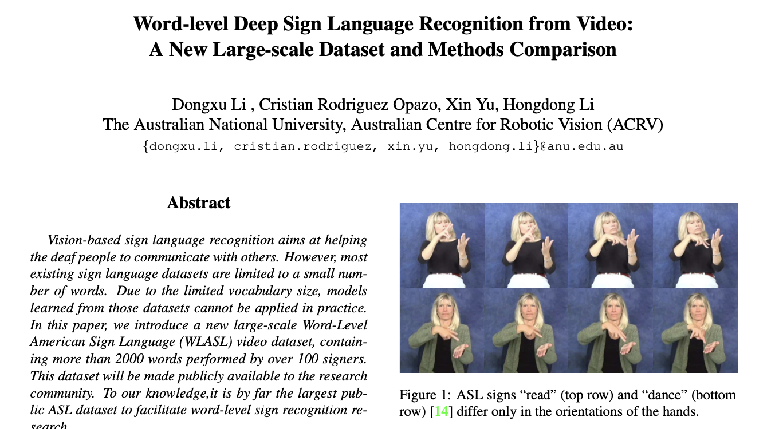
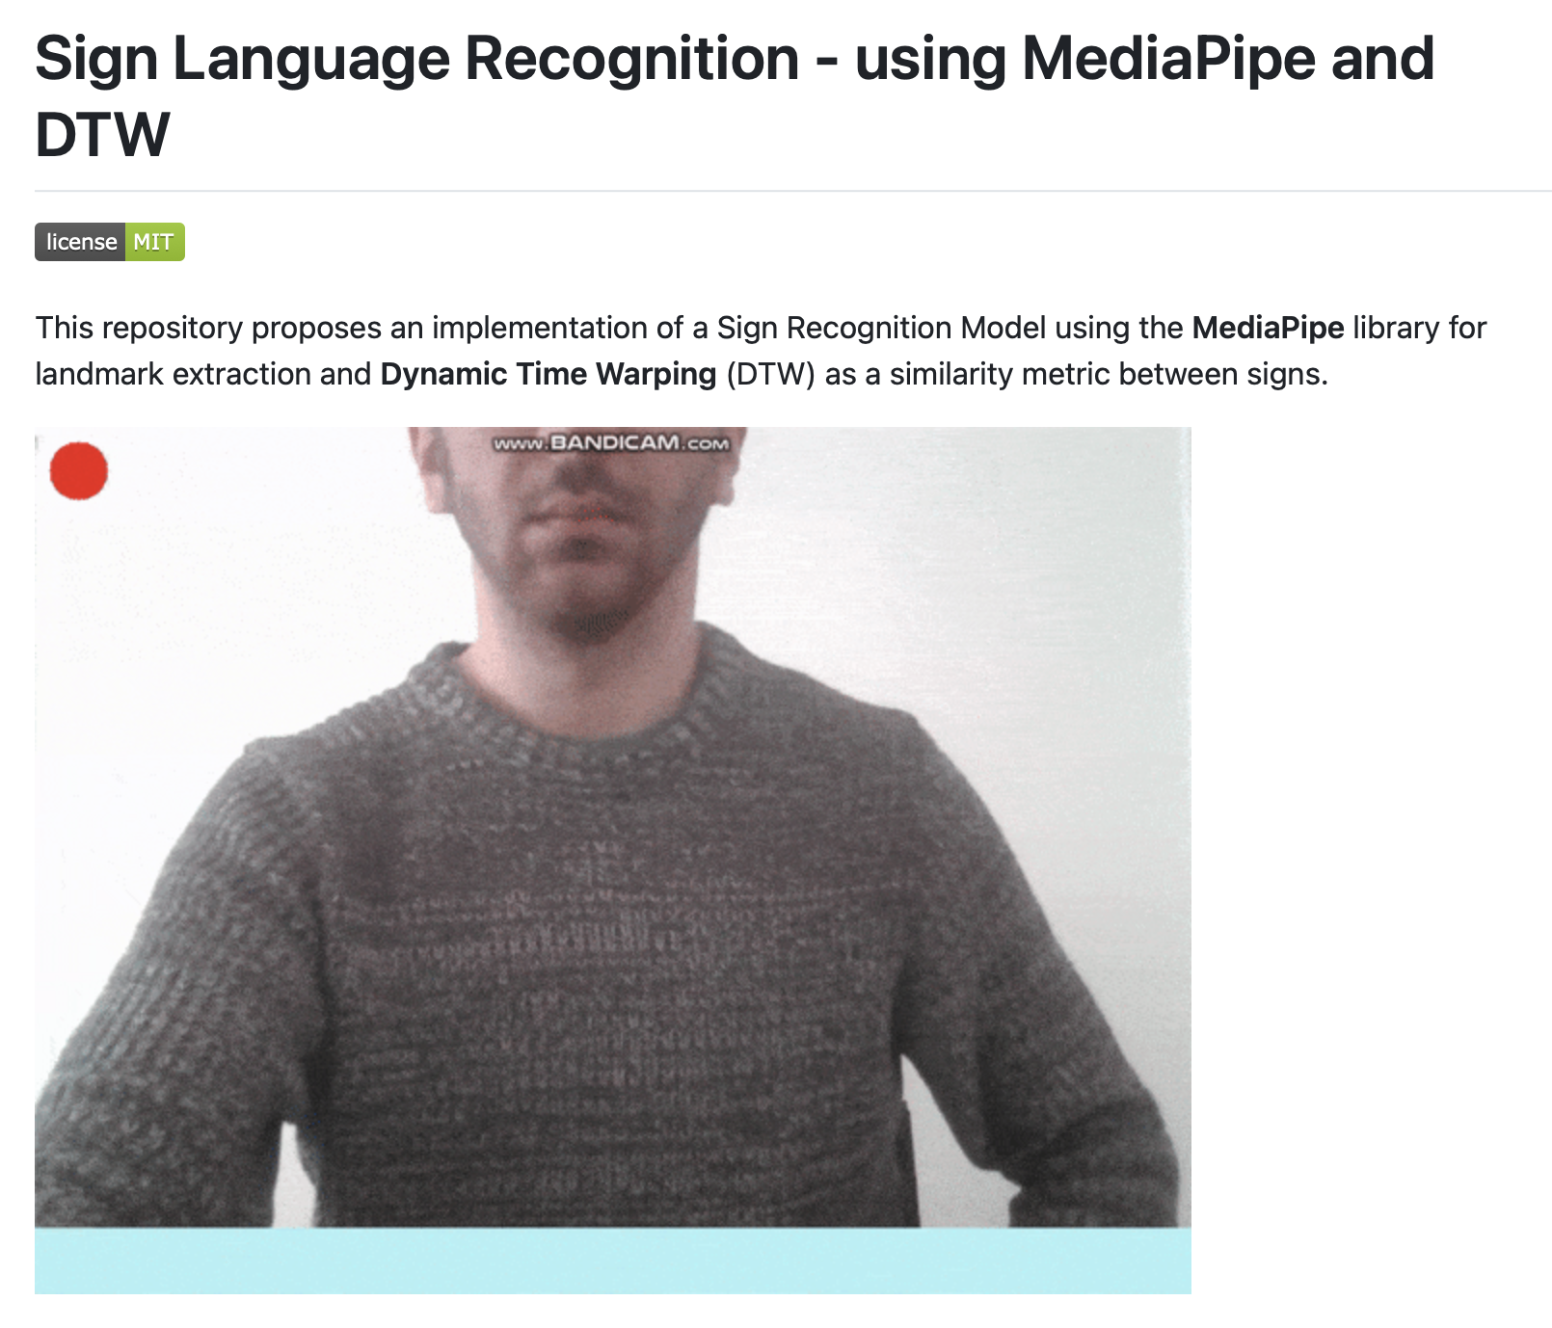
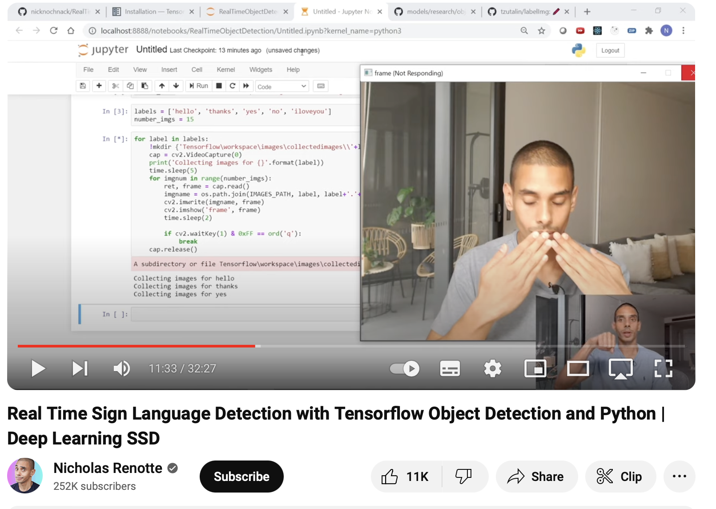
Current Solutions
Research Paper Discussion ^{[1]}
Github Videos ^{[2]} / Youtube Tutorials ^{[3]}
The Gaps in Current Solutions
Easily accessible interface for user to access model in real-time
Application for the collection of new data
[1] https://ieeexplore.ieee.org/stamp/stamp.jsp?arnumber=9093512​
[2] https://github.com/gabguerin/Sign-Language-Recognition--MediaPipe-DTW​
[3] https://www.youtube.com/watch?v=pDXdlXlaCco&t=1653s
Notes:
https://ieeexplore.ieee.org/stamp/stamp.jsp?arnumber=9093512
https://github.com/gabguerin/Sign-Language-Recognition--MediaPipe-DTW
https://www.youtube.com/watch?v=pDXdlXlaCco&t=1653s
Things to cover for this slide:
What are the limitations of current solutions? Remember to cite sources to place your work within the body of work that has already been done.

Slide 4
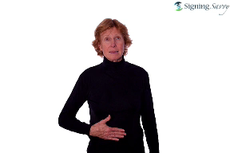
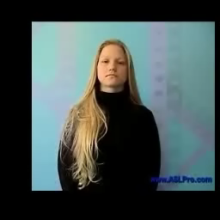
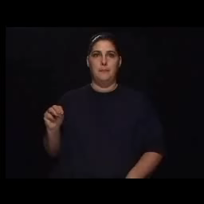
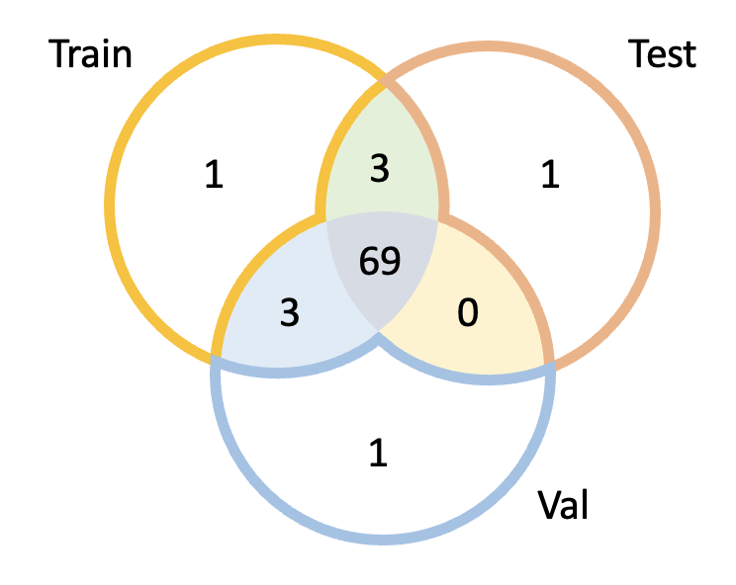
Data Collection
About the Dataset
Created by Dongxu Li and Hongdong Li for the purpose of facillitating research in sign language understanding
Data Format
Json File with Labels for each video + Videos Folder with videos in mp4 / mpeg format
# of Unique Words | 2000
# of Unique Sources | 19
# of Unique Signers | 119
Total Instances | 21,083
Venn Diagram of Signer ID in different data splits
Challenges (solved)
Missing videos in initial dataset -> received full dataset from authors
Notes:
Things to cover for this slide:
What data did you collect, and how did you collect it?
How did you label the data, if applicable?
Provide basic summary statistics about your dataset, such as size, class distribution, and notable patterns, surprises or outliers. -> videos are relatively evenly distributed across classes
Length of video from 0.63s to 8.125s --> average 2.43s
Resolution differs by source, brightness and contrast varies from video to video but within one video it remains quite consistent

Slide 5
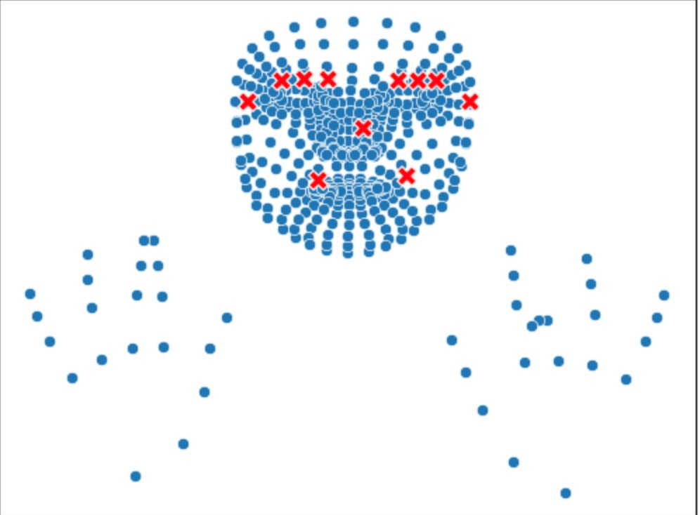
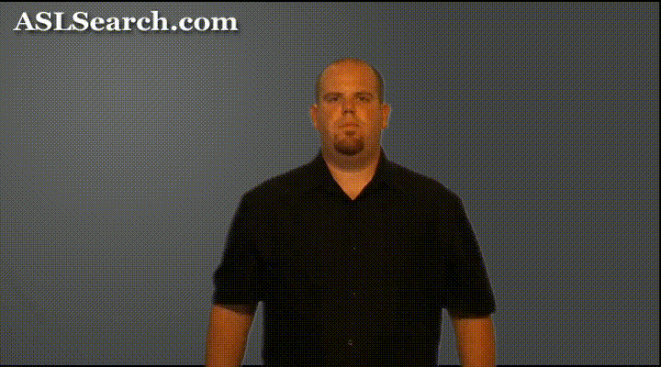
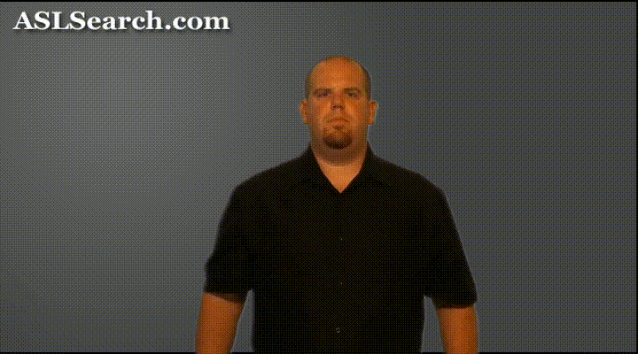
Data Preparation
Data Cleaning
Vague Labelling of Videos
Manually relabelled videos in subset
Embedding Data
Extraction of Landmark points using Mediapipe Library
Both Labelled as "Short"
Why?
Removes background
Greatly reduces size of videos
Future Improvements
Efficient way to identify and relabel videos
Notes:
Things to cover for this slide:
What data preparation was necessary to prepare your dataset for modeling and/or prompting?
What features did you use in your model, and did you build any new features?
Did you eliminate any features from your dataset, and if so, why?
What data cleaning did you perform to remove or fix bad examples?
More augmentation require more computing power

Slide 6
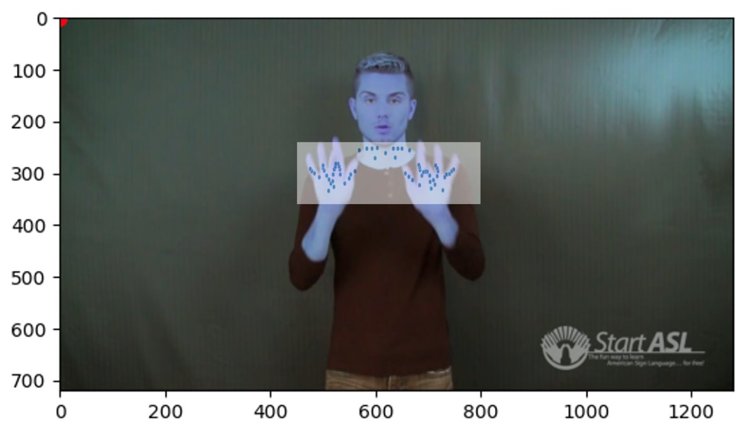
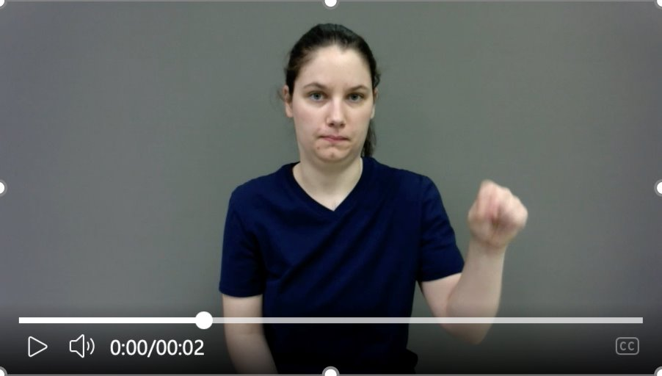
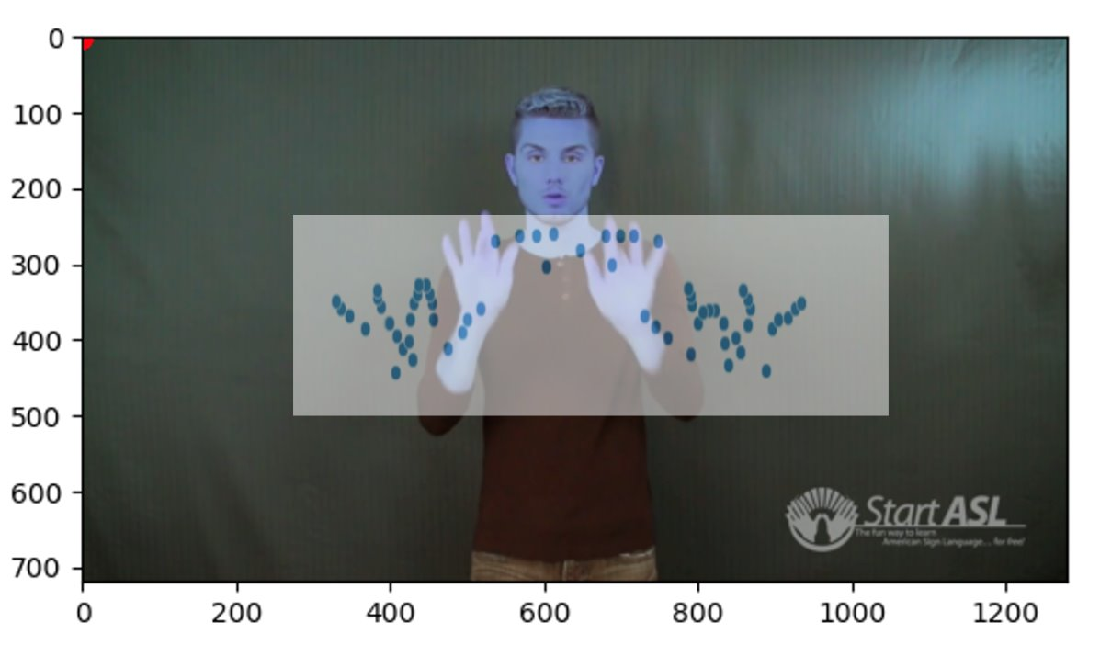
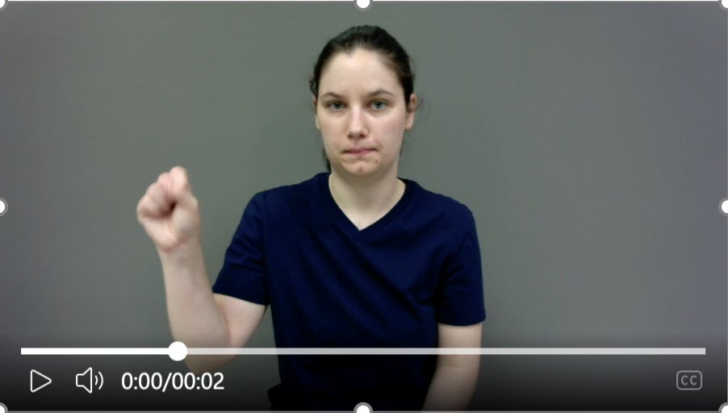
Feature Engineering
Zooming
Catering to possible variation in hand movements
Flipping
Catering to Left and Right handed signers
Notes:
Things to cover for this slide:
What data preparation was necessary to prepare your dataset for modeling and/or prompting?
What features did you use in your model, and did you build any new features?
Did you eliminate any features from your dataset, and if so, why?
What data cleaning did you perform to remove or fix bad examples?
More augmentation require more computing power

Slide 7
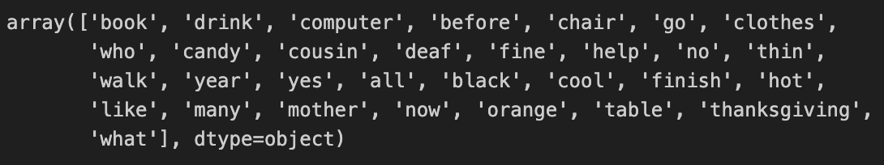
Baseline Model
The Subset: 31 Words
Train: 2265 Videos
Test: 86 Videos
Validation: 109 Videos
Base Model | Accuracy | Precision | Recall | F1 Score
Landmarks (Fixed Frames Count) + Logistic Regression | 0.16 | 0.17 | 0.16 | 0.15
Landmarks (Fixed Frames Count) + SVM | 0.14 | 0.13 | 0.14 | 0.12
Landmarks (Fixed Frames Count) + Random Forest | 0.35 | 0.39 | 0.35 | 0.35
Landmarks (average) + Logistic Regression | 0.22 | 0.18 | 0.22 | 0.18
Landmarks (average) + SVM | 0.22 | 0.25 | 0.22 | 0.22
Landmarks (average) + Random Forest | 0.25 | 0.24 | 0.25 | 0.23
Landmarks (Fixed Frames Count) + LSTM | 0.21 | 0.25 | 0.21 | 0.22
CNN for a single frame | 0.25*
* Much smaller set of words due to lack of computing power
Notes:
Describe the baseline models you used and explain why you chose them.
If relevant, compare your baselines to other benchmarks or industry standards.
Present more than one baseline, if applicable, and discuss how they compare to one another.

Slide 8
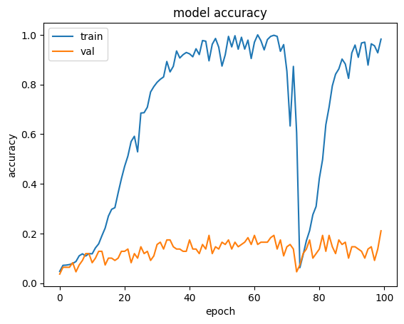
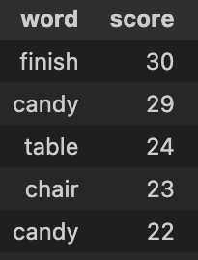
Model Training and Evaluation
Base Model | Accuracy | Precision | Recall | F1 Score
Landmarks (Fixed Frames Count) + LSTM | 0.21 | 0.25 | 0.21 | 0.22
Introducing a new addition to performance evaluation: Score
If the correct word has the 2nd highest probability, it is still good, an LLM can later get a sentence with list of possible words to fit in areas where the confidence is low.
Example prompt to LLM:
Fill the blank with one of the words:
Machine [basketball, learning, shirt] is awesome!
Notes:
Discuss the various models you tried on your data and explain your choices.
Describe how the models performed on a test set and compare their performance to the baselines.
If applicable, explain any hyperparameter tuning you performed and its impact on your results.
If applicable, show a learning curve for your best model built using cross-validation (sample at least 5 points for each amount of training data).
Frame by frame on the landmarks

Slide 9
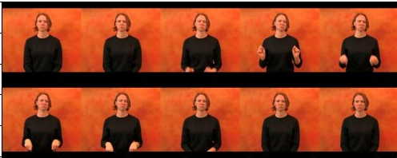

Model Training and Evaluation
Other Attempts
CLIP Embedding Approach
CNN Approach
Very Low Accuracy​
Possible Reason: Domain Shift
Low Accuracy​
Possible Reason: Temporal Variation not captured
More experimentation with data exploration, data augmentations and data explainability may help explain the models' performance
Notes:
Discuss the various models you tried on your data and explain your choices.
Describe how the models performed on a test set and compare their performance to the baselines.
If applicable, explain any hyperparameter tuning you performed and its impact on your results.
If applicable, show a learning curve for your best model built using cross-validation (sample at least 5 points for each amount of training data).
Frame by frame on the landmarks

Slide 10
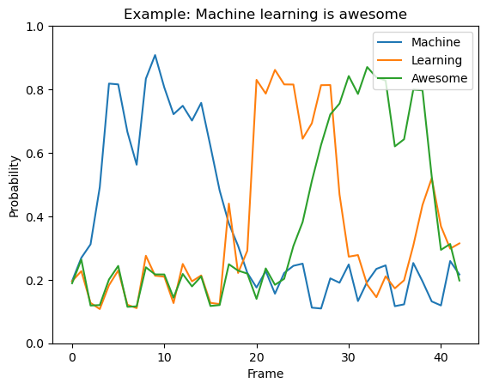

Model Training and Evaluation
Final Model (“Final” means currently selected for deployment)
Model architecture:
CNN analyze each frame individually.
Assigns probability per word per frame.
Analyze results, ensure to clean noise.
Advantages (our hypothesis):
Can be faster, perhaps even fast enough to work on phones.
Accuracy-speed tradeoff, may decrease frame rate for low hardware device.
Accepts infinite video length with live output prediction, 1-2 sec delay.
CNN idea → NN on landmarks of each frames
Notes:
Discuss the various models you tried on your data and explain your choices.
Describe how the models performed on a test set and compare their performance to the baselines.
If applicable, explain any hyperparameter tuning you performed and its impact on your results.
If applicable, show a learning curve for your best model built using cross-validation (sample at least 5 points for each amount of training data).
Frame by frame on the landmarks

Slide 11




Model Deployment
Application Implementation Details
Front-end
Interface implemented using HTML, CSS and Javascript
Back-end
Pre-trained python ML Model containerized in docker
Deployment on Local Host
Deployment on Public Server
Challenges Faced
Limits in File size for Free Plan
Limitations in Computation Power
Notes:
Describe the deployment method you used, including the cloud service, specific method, and any challenges encountered. -> local machine
Explain how you are monitoring your deployed model, including the tools used, metrics tracked, and any alerts or notifications you have or would set up.
User feedback and consent on video

Slide 12
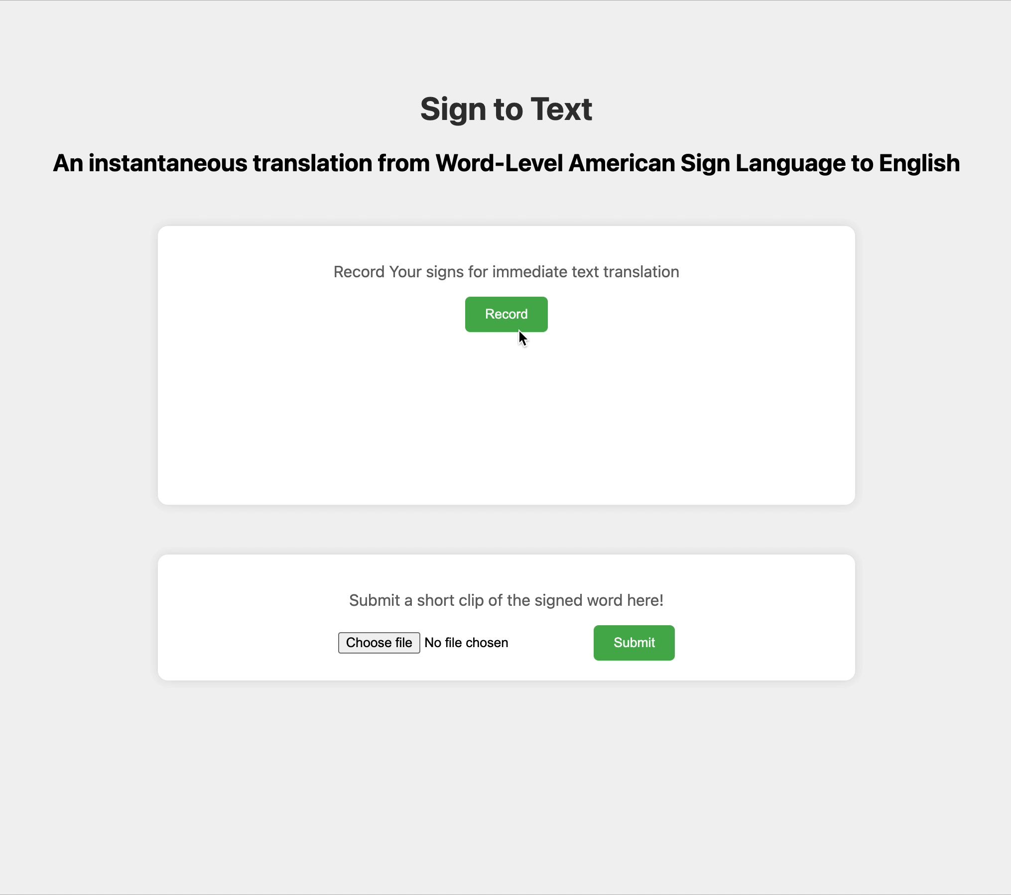
DEMO
Correct:
Cloth
Table
Computer
Probability:
Green > 80%
50% < Orange > 80%
Red < 50%

Slide 13


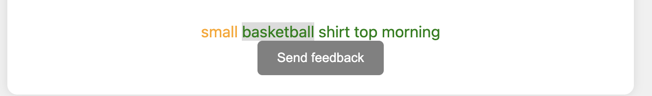
Model Monitoring
Basic Data Collection
User Feedback
Number of Video Submissions
Speed of Processing
Collection of feedback from user regarding answer
Improve User Experience
Provides feedback to model on Accuracy
Notes:
Describe the deployment method you used, including the cloud service, specific method, and any challenges encountered. -> local machine
Explain how you are monitoring your deployed model, including the tools used, metrics tracked, and any alerts or notifications you have or would set up.
User feedback and consent on video

Slide 14


Model Maintenance
Model Efficiency and Performance
Improve accuracy
Data Updates and Collection
Increase Data Size + Ensure Dataset is relevant and updated
Experiment with other machine learning models – current accuracy is not high
Privacy Clause to allow for the collection of user video uploads
Notes:
Explainability not done well enough
Knowledge Gaps

Slide 15
Lesson Learned
Lesson #1:
Spend more time on Model Exploration and Training
Lesson #2:
Importance of Quality of Data
Knowledge Gap
Importance of Data Explainability
Higher data quality, better accuracy
Notes:
Explainability not done well enough
Knowledge Gaps

Slide 16

Moving Forward
Rannís Grant approved for the Summer!
Project Details
Project Name: Sign Language to Text
Goal: Create web interface for the collection of Icelandic sign language dataset
Dataset will be used for the exploration and training of model to translate the Icelandic sign language to text
If any of you is free this summer and want to join me, please let me know at orr3@hi.is.
No requirement for knowledge in Icelandic.
Notes:
Explainability not done well enough
Hopefully

